Slide 1
Oracle SQL
Abed Sharifi
Oracle DBA
SQL Developer
Abed.sharifi@gmail.com

Slide 2
What is SQL ?
SQL (Structured Query Language)
SQL is a computer language aimed to store, manipulate, and retrieve data in relational databases.
SQL lets you access and manipulate databases
SQL is an ANSI (American National Standards Institute) standard

Slide 3
Database concepts
Database
Linking data tables through relationships
Controlling data storing and retrieving
Maintaining data integrity and accuracy
Avoiding data redundancy and inconsistency
Sorting and filtering data

Slide 4
Relational Database
a relational database is a set of tables
Each table keeps information about one thing

Slide 5
Relational Database Management System (RDBMS)
is an application that creates, organizes and edits databases
Microsoft SQL Server
Oracle
Microsoft Access

Slide 6
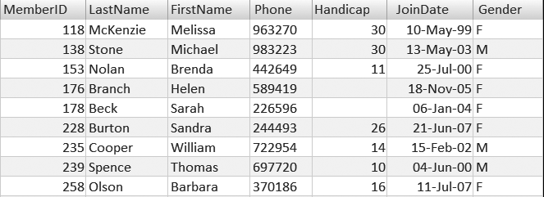
Table Elements

Slide 7
Data Types

Slide 8
Data Type
System Data Type
User Defined Data Type

Slide 9
Data Type Categories
Character Datatypes
Number Datatype
DATE Datatype
LOB Datatypes
RAW and LONG RAW Datatypes
ROWID and UROWID Datatypes
https://docs.oracle.com/database/121/SQLRF/sql_elements001.htm#SQLRF0021

Slide 10
Character Datatypes
Data Type | Description
CHAR[(size)] | store fixed-length character data
NCHAR[(size)] | store fixed-length Unicode character data
VARCHAR2(size) | store variable-length character data
NVARCHAR2(size) | store variable-length Unicode character data
Long | store variable-length character data containing up to 2 gigabytes of information
The LONG datatype is provided for backward compatibility with existing applications. In new applications, use CLOB and NCLOB datatypes for large amounts of character data

Slide 11
Number Datatypes
Data Type | Description
NUMBER [ (p [, s]) ] | Number having precision p and scale s. The precision p can range from 1 to 38. The scale s can range from -84 to 127. Both precision and scale are in decimal digits. A NUMBER value requires from 1 to 22 bytes
FLOAT [(p)] | A subtype of the NUMBER data type having precision p. A FLOAT value is represented internally as NUMBER. The precision p can range from 1 to 126 binary digits. A FLOAT value requires from 1 to 22 bytes.
BINARY_FLOAT | 32-bit floating point number. This data type requires 4 bytes
BINARY_DOUBLE | 64-bit floating point number. This data type requires 8 bytes

Slide 12
Date Datatypes(1)
Data Type | Description
DATE | Valid date range from January 1, 4712 BC, to December 31, 9999 AD
TIMESTAMP[(X)] | Year, month, and day values of date, as well as hour, minute, and second values of time
TIMESTAMP [(X)] WITH TIME ZONE | All values of TIMESTAMP as well as time zone displacement value
TIMESTAMP [(X)] WITH LOCAL TIME ZONE | Data is normalized to the database time zone when it is stored in the database. When the data is retrieved, users see the data in the session time zone.
X
fractional_seconds_precision

Slide 13
Date Datatypes(2)
Data Type | Description
INTERVAL YEAR [(year_precision)] TO MONTH | Stores a period of time in years and months
INTERVAL DAY [(day_precision)] TO SECOND [(X)] | Stores a period of time in days, hours, minutes, and seconds
X
fractional_seconds_precision

Slide 14
LOB Datatypes
Data Type | Description
CLOB | A character large object containing single-byte or multibyte characters
NCLOB | A character large object containing Unicode characters
BLOB | A binary large object. Maximum size is (4 gigabytes - 1) * (database block size)
BFILE | Contains a locator to a large binary file stored outside the database
X
fractional_seconds_precision

Slide 15

Database Constraints

Slide 16

Not null Constraints
A null value is an unknown
Null value is not as zero or space.

Slide 17

Unique Constraints

Slide 18

Unique Constraints
every value in a column or set of columns must be unique.
When there is not the primary key.
Example
no two employees can have
the same phone number

Slide 19
Primary key
The primary key value must be unique and not null.
Multiple UNIQUE constraints and only one Primary key in a Table .

Slide 20
Foreign key
FOREIGN KEY in one table points to a PRIMARY KEY in another table.
prevents that invalid data form being inserted into the foreign key column

Slide 21
Check Constraints
used to limit the value range that can be placed in a column.
Example :
A column must only include integers greater than 0

Slide 22
DEFAULT Constraint
used to insert a default value into a column

Slide 23
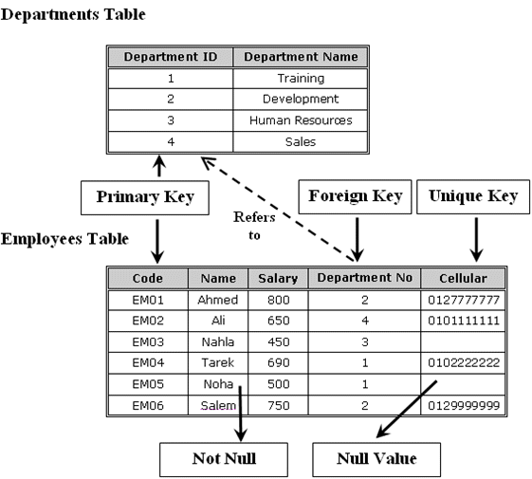

Slide 24
Database Relationships

Slide 25
Relationship Types
One-to-one relationship
One-to-many relationship
Many-to-many relationship
Recursive relationship
Referential integrity

Slide 26
One To One Relationships
One Record
One Record

Slide 27
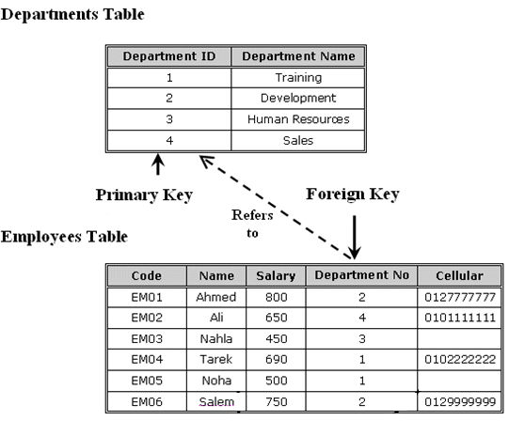
One To Many Relationships

Slide 28
One To Many Relationships
One Record
Record 1
Record 2
Record 3

Slide 29
Many To Many Relationships
Record 1
One Record
Record 1
Record 2
Record 2
Record 3
Record 3

Slide 30
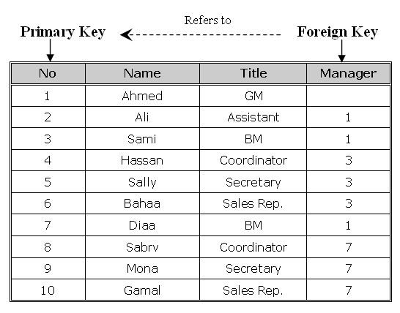
Recursive relationship

Slide 31
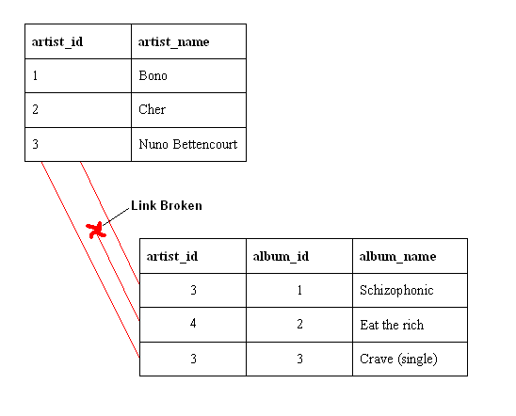
Referential integrity
You cannot add a value in a foreign key without a matching value in a primary key.
it prevents deleting a primary key that there is a foreign key related to it

Slide 32
Database Normalization

Slide 33
Normalization Overview
Definition
the process of organizing data to minimize redundancy
the process of decomposing large, inefficiently structured tables into smaller, more efficiently structured tables without losing any data in the process .
the process of reducing tables to a set of columns where all the non-key columns depend on the primary key column

Slide 34
First normal form
rules
Table must describe only a single object.
A single field must not contain multiple data values.
Table must not include repeated fields in the same column.
Repeated fields must be removed to a related table.
Create separate tables for each group of related data.
Identify each row with a unique identifier (primary key).

Slide 35
Problem
The CourseCategory column contains repeated values for the rows.
The CourseInfo column contains multiple data values in each field
Solution
CourseCategory > to separate table (Categories)
One-Many relationships (Category to Course )
CourseInfo > to two columns(start date , branch)
You need to create branches Tables .

Slide 36
Second normal form
rules
Meet all the requirements of the first normal form.
Data in all non-key columns must fully depend on the value of the primary key column or the composite primary key columns.

Slide 37
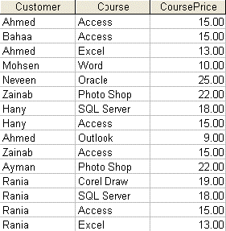
Example

Slide 38
Problem
CoursePrice depending only on the course column
Solution
CoursePrice column > Course Table

Slide 39
Third normal form
Rules
Meet all the requirements of the first normal form.
Meet all the requirements of the second normal form.
Data in all non-key columns must fully describe the value of the primary key column or the composite primary key columns.

Slide 40
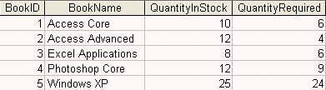
Example

Slide 41
Problem
QuantityInStock column and the QuantityRequired
Solution
QuantityInStock column and the QuantityRequired column must be removed to the book transactions table that fully describes the stock control for the books rather than describing the book itself as an object

Slide 42
Denormalization
Definition
the opposite of normalization
Why
to optimize the performance of a database
if many relations are joined, it may be too slow then to retrieve information

Slide 43
SQL Queries

Slide 44
Working with Oracle 12C

Slide 45
Introduction to Oracle SQL

Slide 46
SQL Commands
Data Definition Language (DDL)
Create , Alter , Drop , Truncate, Replace, Comment
deal with the structure of the database objects (the object itself) like tables, views, procedures and so on.
Data Manipulation Language (DML)
Select, Insert , Delete , Update , Merge
deal with the contents of the tables rather than the structure of the tables
Data Control Language (DCL)
Grant, Revoke
maintain security of the database objects access and use
Transaction Control
Commit, Rollback, Savepoint

Slide 47
Data Definition Language (DDL)
CREATE
adding a new database object to the database
ALTER
changing the structure of an existing database object
DROP
removing a database object from the database permanently
TRUNCATE
removing all rows from a table without logging the individual row deletions
COMMENT
Add comments to the data dictionary

Slide 48
Data Manipulation Language (DML)
SELECT
retrieving data from the database by specifying which columns and rows to be retrieved
INSERT
adding a new row (and not column) into the table
UPDATE
modifying the existing data in the tabl
DELETE
removing an existing data from the table
Merge(Upsert)
performs a series of conditional Update and/or Delete and/or Insert operations

Slide 49
Data Control Language (DCL)
GRANT
giving privileges to the users
REVOKE
removing privileges from the users that are previously granted those permissions

Slide 50
Retrieving Data Customizing Data

Slide 51
SELECT
Definition
Retrieve data from database
Syntax
SELECT * | column1 [, column2, …….]
FROM table
[WHERE conditions]
[ORDER BY column1 [, column2, ……..] ASC, DESC]

Slide 52
WHERE
Definition
Specify a condition to limit the result
Syntax
SELECT * | column1 [, column2, …….]
FROM table
[WHERE conditions]

Slide 53
Order BY
Definition
sort the retrieved rows by a specific column or set of columns
Syntax
SELECT * | column1 [, column2, …….]
FROM table
[WHERE conditions]
[ORDER BY column1 [, column2, ……..] ASC, DESC]

Slide 54
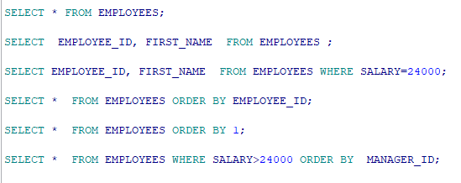
Example
Notes:
SELECT * FROM EMPLOYEES;
SELECT EMPLOYEE_ID, FIRST_NAME FROM EMPLOYEES ;
SELECT EMPLOYEE_ID, FIRST_NAME FROM EMPLOYEES WHERE SALARY=24000;
SELECT * FROM EMPLOYEES ORDER BY EMPLOYEE_ID;
SELECT * FROM EMPLOYEES ORDER BY 1;
SELECT * FROM EMPLOYEES WHERE SALARY>24000 ORDER BY MANAGER_ID;

Slide 55
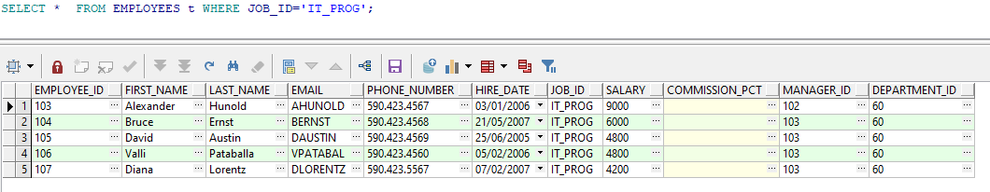
Example

Slide 56
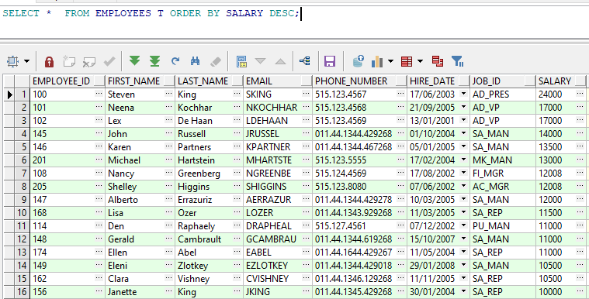
Example

Slide 57
SQL AND & OR Operators
AND
The AND operator displays a record if both the first condition AND the second condition are true.
OR
The OR operator displays a record if either the first condition OR the second condition is true.
SELECT *
FROM EMPLOYEES
WHERE LAST_NAME = 'King'
AND JOB_ID = 'IT_PROG';
SELECT *
FROM EMPLOYEES
where JOB_ID = 'SA_REP'
OR JOB_ID = 'IT_PROG';
Notes:
SELECT *
FROM EMPLOYEES
WHERE LAST_NAME = 'King'
AND JOB_ID = 'IT_PROG';
SELECT *
FROM EMPLOYEES
where job_id = 'SA_REP'
OR job_id = 'IT_PROG';

Slide 58
NULL
In the database world, NULL is special. It is a marker for missing information or the information is not applicable
SELECT * FROM EMPLOYEES WHERE MANAGER_ID IS NULL;
SELECT * FROM EMPLOYEES WHERE MANAGER_ID IS NOT NULL;
SELECT EMPLOYEE_ID, COMMISSION_PCT, NVL(COMMISSION_PCT, 0)
FROM EMPLOYEES t;

Slide 59
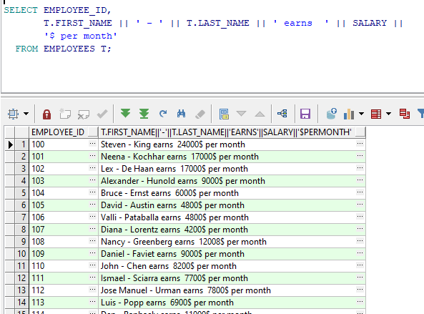
Concatenate

Slide 60
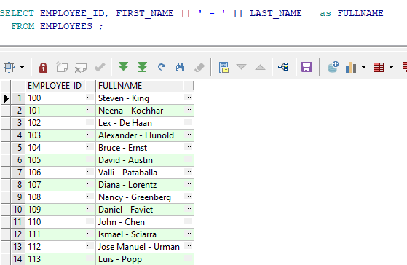
Aliases (as)

Slide 61
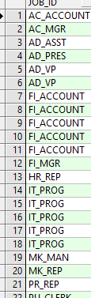
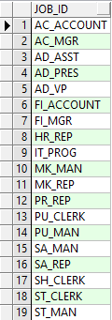
Distinct
eliminates duplicate row values from the results
SELECT JOB_ID FROM EMPLOYEES ;
SELECT DISTINCT JOB_ID FROM EMPLOYEES ;
1
2
2
1

Slide 62
Grouping Data

Slide 63
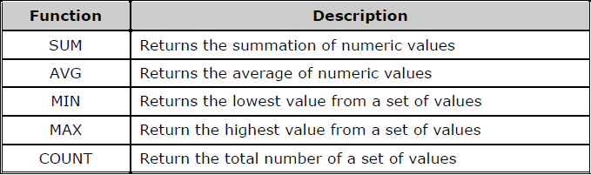
Grouping Functions

Slide 64
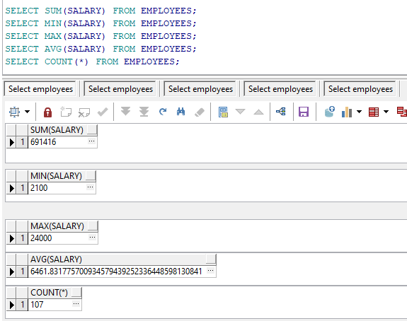
Example 1
Notes:
SELECT SUM(SALARY) FROM EMPLOYEES;
SELECT MIN(SALARY) FROM EMPLOYEES;
SELECT MAX(SALARY) FROM EMPLOYEES;
SELECT AVG(SALARY) FROM EMPLOYEES;
SELECT COUNT(*) FROM EMPLOYEES;
SELECT COUNT(MANAGER_ID) FROM EMPLOYEES;
SELECT COUNT(EMPLOYEE_ID) FROM EMPLOYEES;

Slide 65
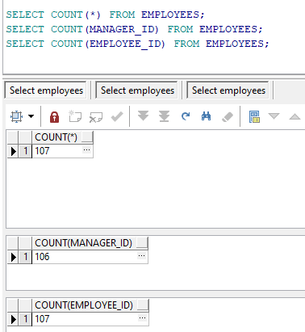
Example 2

Slide 66
Group By
Definition
used to divide the rows in a table into smaller groups
Syntax
SELECT column1, group_function (column2), …….
FROM table
[WHERE conditions]
[GROUP BY column1, ……..]
[ORDER BY column1 [, column2, ……..] ASC, DESC]

Slide 67
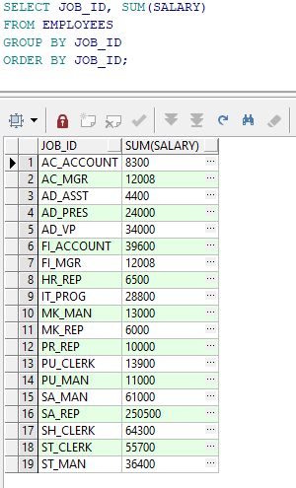
Example : Group By

Slide 68
Having
Definition
used to restrict the group results
Syntax
SELECT * | column1, group_function (column2), …….
FROM table
[WHERE conditions]
[GROUP BY column1, ……..]
HAVING [conditions]
[ORDER BY column1 [, column2, ……..] ASC, DESC]

Slide 69
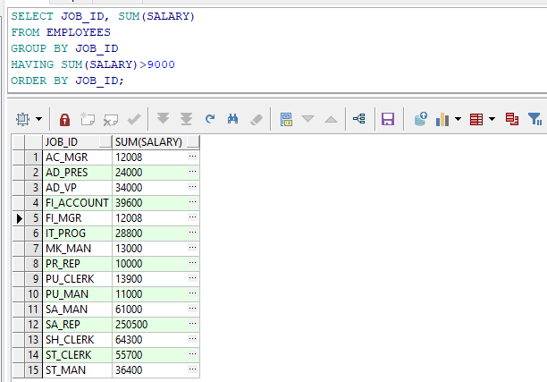
Example : Having

Slide 70
SQL Operators

Slide 71
Using SQL Operators
Arithmetic operators
Comparison operators
Logical operators
Set Operators
Other operators

Slide 72
Arithmetic operators
addition (+)
subtraction (-)
multiplication (*)
division (/).

Slide 73
Comparison operators
compare two or more values
Description | Operator
Equal | =
Lease than | <
Greater than | >
Less than or equal | <=
Greater than or equal | >=
Not Equal | <>

Slide 74
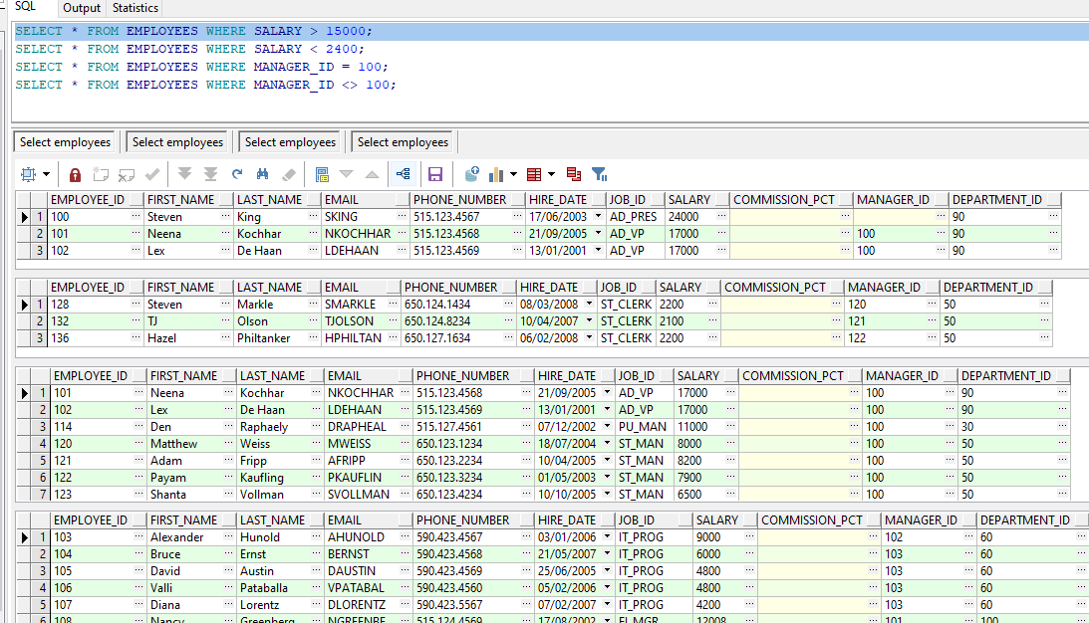
Example
Notes:
SELECT * FROM EMPLOYEES WHERE SALARY > 15000;
SELECT * FROM EMPLOYEES WHERE SALARY < 2400;
SELECT * FROM EMPLOYEES WHERE MANAGER_ID = 100;
SELECT * FROM EMPLOYEES WHERE MANAGER_ID <> 100;

Slide 75
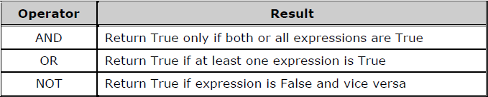
Logical operators
Used to get a logical value (True or False)

Slide 76
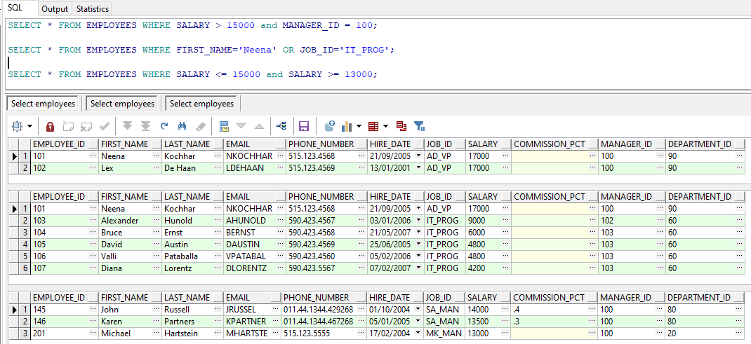
Example
Notes:
SELECT * FROM EMPLOYEES WHERE SALARY > 15000 and MANAGER_ID = 100;
SELECT * FROM EMPLOYEES WHERE FIRST_NAME='Neena' OR JOB_ID='IT_PROG';
SELECT * FROM EMPLOYEES WHERE SALARY <= 15000 and SALARY >= 13000;

